Slide 1
Platforms: Lecture 9: I/O and Interrupts

Slide 2
Is I/O needed?
Regardless of CPU power, a computer system’s usefulness depends on input and output facilities.
Without I/O, you cannot have:
Keyboard input
Screen output
Printout
Disk storage and retrieval
Network access, etc.
To CPU and its programs, all devices require specialised input and output processing facilities and routines
Many slides using pictures from Englander (2003) and Silberschatz (2005)

Slide 3
I/O Characteristics 1
I/O is often the predominant factor, especially in business and multi-media applications
web services (e.g. e-commerce) require massive amounts of fast I/O to handle and process I/O requests as they occur (i.e. in real-time)
PCs have rapidly increased in CPU capability but I/O processing is still limited ∴ mainframe computers with better I/O capability still used for business processing

Slide 4
I/O Characteristics 2
Requires that blocks of data (not individual words) can be transferred
Distinguishing and separating each individual I/O from many different devices all trying to do I/O - often at the same time
Different devices operate at different speeds to each other and the CPU, e.g.
printer 500 characters /sec (dot matrix serial )
HDD: 1200MB/sec (SATA 1)
CPU FSB transfer: 3200 MB/sec (32bit wide@800MHz)
so synchronization needed to avoid data loss

Slide 5
I/O Characteristics 3
I/O takes time.
From the CPUs point of view it has sent a block of data to (e.g.) the HDD with a single instruction
BUT time is wasted waiting for the completion of the task
the CPU should be able to perform other tasks whilst I/O transfers are taking place

Slide 6
Characteristics of basic I/O devices
Keyboard
Character based device
Transfers of Unicode or ASCII, one character at a time
Very slow cf. to capability of computer to execute input instructions
Computer spends most of its time waiting for input
Input of two types
Expected by application program (requesting input data)
Unexpected: user wishes to interrupt what computer is doing

Slide 7
Characteristics of basic I/O devices
Mouse
Low data rates
Computer spends most of its time waiting for input
Input types
Expected by application program (requesting input data) e.g. when clicking mouse button
Unexpected: mouse button click to change the way the program is executing
Mouse move: cursor moves on screen

Slide 8
Characteristics of basic I/O devices
Printer
In text mode
Occasional pages of text, 12,000 characters/sec for laser
LOW data rate
graphical output
Depends on whether vector graphic sent (with internal conversion in printer) OR bitmap

Slide 9
Characteristics of basic I/O devices
CRT Monitor
In text mode
LOW data rate
graphical output
All images displayed as Bitmaps
Data rate required depends on whether vector graphic sent (with internal conversion in monitor) OR bitmap
Single colour bitmap image 90Mb (A4 page at 600 dpi), & printed in 10 seconds = 9MB/s
Video 600MB/s (HD-1080p @ 32 bit)

Slide 10
Characteristics of basic I/O devices
Monitor – CRT & LCDs
Analog
XGA (1024x768 pixels ), refresh rate 75Hz, 24 bit/pixel = ?? Bits/sec
DVI driving analog CRT (internal conversion)
24 bits/pixel
1.65 Gbits/s (max)
Flat screen
1.65 Gbits/s
Notes:
XGA
Refresh rate is VERTICAL refresh rate, i.e. writes the 1024 lines 75 times a second (and each line has 768 pixels)
1024 x 768 x 75 x 24 = 1415577600 bits/sec = 1.4 Gbits/s = 177 MB/s
Need better than 60 Hz refresh rate to avoid flicker
DVI – is specification for a single link. Internal (to CRT) conversion

Slide 11
Characteristics of basic I/O devices
Video & Audio requirements
Both require steady stream of data over long periods of time (to prevent dropouts)
Most other devices have occasional bursts of data

Slide 12
Characteristics of basic I/O devices
Network
Computer sees it as another I/O device
Small textfiles: 56kB/s
Large files, pictures, video: 50MB/s
Network could be seen as another disk – remote storage
If computer is a server – massive I/O demands, especially if transferring graphical info from computer to a remote desktop
Simple text – dial-up modem speed 56kB/sec perfectly adequate
Downloads of large files; Video high speed required: 50 MB/s Hence broadband

Slide 13
Characteristics of basic I/O devices
Under CPU/Program control:
Program executing in the CPU which control what should be output to screen; what transfers to and from disk, etc.
Disk, printers, screen
Devices generating input to CPU independent of program
Keyboard, mouse, voice input, requests across LAN,
Some input devices under program control but who supply data irregularly
Telemetering/ measuring devices, also keyboard input to WP
Provision needs to be made to handle these
I/O device being addressed may be busy or not ready
Desirable for device to provide status information to CPU (no paper or ink signals from printers)

Slide 14
Measuring I/O performance
Bandwidth: how much data can flow through the system per second?
Latency: how long does it take to initiate an I/O process
If I/O requests are large, response time will depend on bandwidth
For small accesses, the I/O system with lowest latency will deliver the best response time
I/O devices vary widely in behaviour (input, output, or storage) and data rates (0.01 KB/s keyboard to 30 MB/s for a graphics display)

Slide 15
Requirements to handle I/O
Able to individually address different peripheral devices
Means for peripheral device to initiate communication with CPU (so it can respond to unexpected inputs from keyboards, mice and networks, and peripherals can convey emergency status information to the executing program
Efficient means of transferring data between I/O and memory (e.g. programmed I/O for word transfers, DMA)
Means for handling devices with extremely different control requirements
Be nice if I/O for each device could be handled similarly by programs in CPU, so need an I/O module as standardised interface and unique interface modules per device

Slide 16
Buses
I/O devices usually connected to processor using a bus
Shared communication link using one set of wires to connect multiple subsystems
Bus has set of data lines for data and address transfers and set of control lines for request / acknowledge signals
Provides versatility (new devices can be added and peripherals moved between computers) and low cost (single set of wires connects many devices) BUT can be a bottleneck in system

Slide 17
Buses
Three classes of bus:
Processor-memory: short high performance matched to memory
I/O: long, wide range of data rates, used to connect diverse devices
Backplane: used to connect subsystems in a chassis – processor, memory, I/O plug into backplane
Bus organisations:
Single bus for processor, memory and I/O
Separate high-speed bus for processor-memory traffic with slower I/O buses interfacing to this through bus adapters to match speeds
As above, but with smaller number of taps into high-speed processor-memory bus and a backplane bus joining the separate I/O buses

Slide 18
Synchronous or Asynchronous
Synchronous: control includes a clock signal, and so all transfers are relative to the clock
Asynchronous: no clock, every transfer is acknowledged by recipient before more data is sent
Synchronous buses run at speed of slowest device on the bus as every device uses same clock signal
Clock skew (difference in time between seeing the clock edge at different positions on the bus) limits bus length
Synchronous buses run very fast and often used for processor-memory buses as devices close and can run at high clock rates.

Slide 19
Asynchronous and Handshaking
Asynchronous bus can cope with a wide variety of devices and data rates and can be lengthened without clock skew issues
I/O buses normally asynchronous
Use a handshaking protocol – a simple protocol needs 3 control lines
ReadReq: used to indicate a read request, put address on data lines at the same time
DataRdy: used to indicate that data is now available on data lines
Ack: used to acknowledge ReadReq or DataRdy signal of the other party

Slide 20
Handshaking Protocol
Device raises ReadReq and puts address on data lines
Memory sees ReadReq, reads address, raises Ack
I/O sees Ack, releases ReadReq and data lines
Memory sees ReadReq low, drops Ack and prepares data
Memory puts data on data lines and raises DataRdy
I/O sees DataRdy, reads data and raises Ack
Memory sees Ack, releases DataRdy and data lines
I/O sees DataRdy low and drops Ack
New bus transaction can now begin

Slide 21
Masters, Slaves and Arbitration
Need to control access to the bus so that a device can reserve it for use
Solution: 1 or more bus masters, which initiate and control all bus transactions
Processor always a bus master as it must initiate and control bus transactions with memory, and memory as a slaves as it never initiates bus transactions
Single bus master is computationally expensive as processor must be involved in every bus transaction
Multiple bus masters requires bus arbitration – a device wishing to use the bus asserts a bus request line and is (later) granted access; each device has a bus priority and arbitration scheme serves by priority

Slide 22
Arbitration Schemes
Simple scheme is daisy chain arbitration
Devices signal requests to bus arbiter, which passes bus grant signal through all devices from highest to lowest priority. If a device wants the bus, it becomes master and passes on a low bus grant signal. A release line is asserted on transaction completion
Daisy chain does not assure fairness - low priority signals could be blocked indefinitely
Central bus arbitration chooses fairly but can become a bottleneck
Other alternatives include distributed arbitration by self selection and distributed arbitration by collision detection

Slide 23
I/O Operational Models
I/O events presented to processor using memory mapped I/O where each device appears as a set of data and control registers at a particular address. Control register contains various status bits that can be examined
Programmed I/O
CPU controlled I/O, requires processor to continually check status registers to see if an event needs servicing “polling”
Interrupt Driven I/O
External input controls
Direct Memory Access Controllers
Method for transferring data between main memory and a device that bypasses the CPU

Slide 24
Programmed I/O
Under control of a program, the CPU puts the appropriate address and appropriate data into the registers
Slow – as full fetch execute cycle must be performed for each and every I/O data word to be transferred
One word transfers
Used for keyboards, mice, or for transmission of network commands
Small quantities of data that can be handled one character at a time

Slide 25
Programmed I/O module

Slide 26
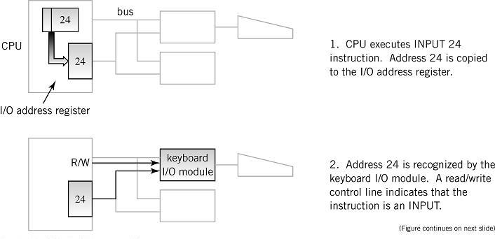
Programmed I/O Example 1

Slide 27
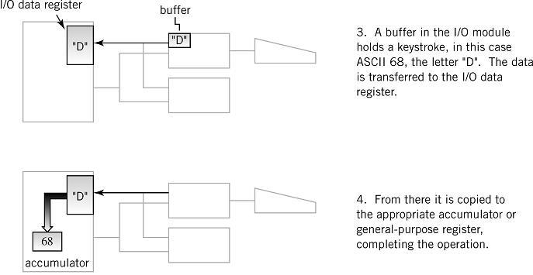
Programmed I/O Example 2

Slide 28
Interrupts
More efficient alternative is interrupt driven I/O
I/O devices generates a signal to alert the CPU that it needs attention and this causes the CPU to alter its normal flow on instruction execution
frees CPU from waiting for events
provides control for external input
Examples
unexpected input
abnormal situation
illegal instructions
multitasking, multiprocessing

Slide 29
Interrupts 2
When an I/O device generates an interrupt (via control lines on the CPU), the CPU then:
Stops executing the current process, which includes saving the context of the current program being executed.
Finds the cause of the interrupt: which device?
Services the interrupt by setting the Program Counter to the starting address of an interrupt handler program
Resumes execution of the original process
Interrupts may be prioritised
Interrupts will typically disabled while an interrupt is being handled

Slide 30
Interrupts 3
Interrupt lines (hardware)
PCs generally have 8 or 15 interrupt lines (IRQ1 …. IRQx)
Interrupt request
Interrupt handlers (aka interrupt routine)
Program that services the interrupt
Process Control Block (PCB)
Located in a part of memory known as the stack area
All registers of a program are saved here before control is transferred to the interrupt handler
Servicing the interrupt
suspends program in progress
saves pertinent information including last instruction executed and data values in registers in the PCB (process control block)
branches to interrupt handler

Slide 31
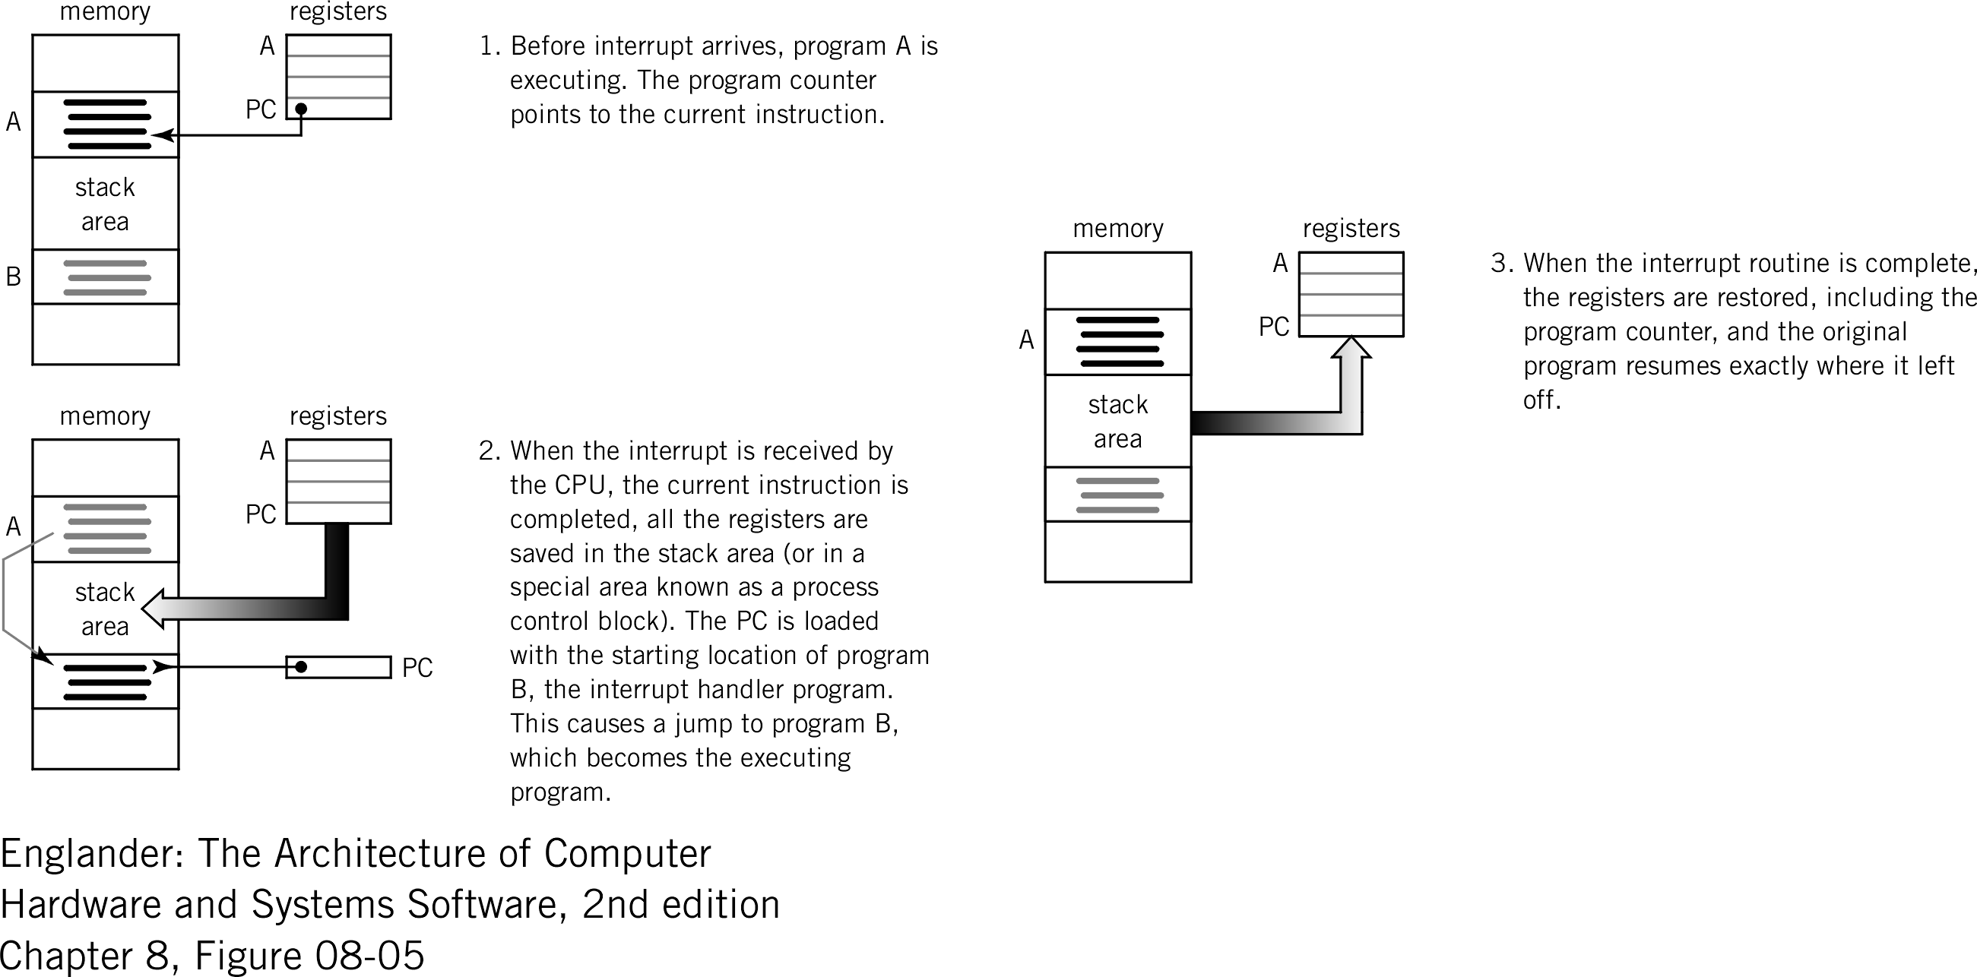
Servicing an Interrupt

Slide 32
Use of Interrupts 1
Notify that an external event has occurred
real-time or time-sensitive, external event notifier - frees CPU from polling, a means for the user to control the computer from an input device
Signal completion
means of controlling the flow of data to an external device, I.E. device will let the CPU know it is ready for (more) data, e.g. printer ready or buffer full
Allocate CPU time
time sharing
e.g. to different programs (multi-tasking), an internal clock times the execution of programs and sends an interrupt to the CPU

Slide 33
Use of Interrupts 2
Indicate abnormal event (CPU originates for notification and recovery)
hardware error, power failure, illegal instructions (/ by 0), non-existent OPCODE, byte error, internal interrupts - traps or exceptions
Software interrupts
SW simulation of interrupts, address space indicates which interrupt is called (INT)

Slide 34
Multiple Interrupts
Identifying devices
Polling: interrupts jumps to polling routine checking for input in rotation, then to appropriate interrupt routine
Vectored interrupts: Interrupt includes address of interrupting device
Interrupt priorities
Loss of data vs. task completion
Maskable (disabled) interrupts

Slide 35
Direct Memory Access
Interrupt-driven I/O relieves processor from having to wait for every I/O event
Can still be a huge load on CPU for high bandwidth devices (e.g. hard disks) as these could generate so many interrupts that 100% of CPU activity needed
Need a mechanism to allow device to transfer data directly to or from memory without involving the CPU (direct memory access)
A DMA controller becomes bus master while transfer is in progress. CPU is still interrupted but only at start and end of each DMA transfer or on an error, not on every bus transaction. Can transfer large amounts of data

Slide 36
Direct Memory Access
Application program requests I/O service from operating system (privileged instructions)
Processor sets up DMA using programmed I/O by supplying the controller the identity of the device, the operation to perform, source/destination memory address and the number of bytes to transfer
DMA controller starts the operation and acquires the bus. Data block transfer (possibly involving many bus transactions) is performed. After each transaction, the DMA controller updates the memory read/write address
Once the DMA transfer is complete, the DMA controller interrupts the CPU, which then becomes bus master and checks that the operation completed successfully

Slide 37
DMA and Virtual Memory
DMA creates problems for virtual memory systems
Should the DMA controller use virtual or physical page addresses?
If physical addresses, then all DMA transfers must be constrained to stay within one page
If virtual addresses, then DMA controller must be provided with all the page mappings it needs for the transfer
OS must cooperate by not moving pages around while a DMA transfer is in progress.

Slide 38
DMA and Caches
Two problems:
If DMA places data directly from disk into memory, stale data might end up in the cache which the processor receives the next time it does a read
If the cache is write-back, then DMA might transfer stale data from memory to disk, bypassing newer data in the cache
Three solutions:
Route all DMA activity through cache (wasteful of cache space)
Have OS invalidate the cache for an I/O write or force write-backs for an I/O read (cache flushing)
Selectively flush or invalidate individual cache entries for DMA (most complex solution)

